Slide 1
Community Engaged Learning:
Understanding Opportunities, Challenges, and Resources

Slide 2
Roadmap & Goals for Session
Agenda
Intro
What is CEL?
Discussion
Existing Opportunities & Funding Mechanisms
Next Steps
Introductions
Name
Department
What you hope to learn in this session?

Slide 3
Our Goals for Session
Establish shared definition of CEL
Advance our understanding of campus perceptions and challenges
Share current resources and opportunities
Generate ideas for new resources and how best to support CEL efforts

Slide 4
Defining CEL at TCNJ

Slide 5
CEL Learning Goals
Social Knowledge
Identify the causes of significant social issues
Diversity of Communities
Engage as part of diverse communities in culturally and contextually appropriate ways
Application of Knowledge
Analyze and address social issues using disciplinary and/or course-based knowledge and skills
Systems & Structures
Identify how systems of privilege and oppression affect individual and group opportunities and experiences
Civic Responsibility
Actively contribute to sustaining and enhancing communities as members of local, regional, national, and global communities
Civic-Identity & Commitment
Demonstrate goals to live a life of critically informed community engagement

Slide 6
COMMUNITY ENGAGED LEARNING
Education
Action
Reflection
Service
Advocacy
Activism
Politics

Slide 7
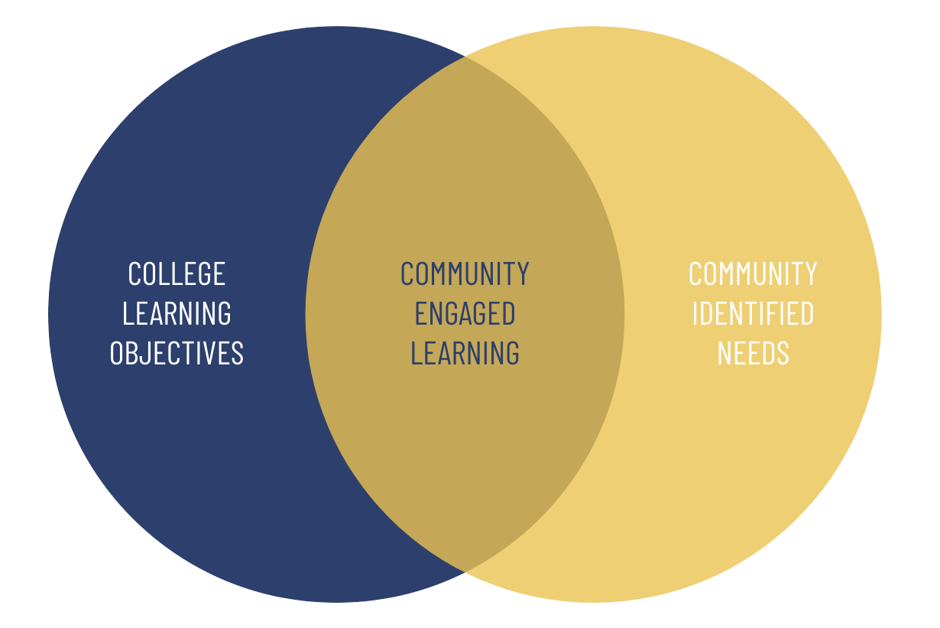

Slide 8
Connection to Campus Plans

Slide 9
Undergraduate Enrollment: TCNJ will educate more students from a wider range of backgrounds.
Curricular Experience: TCNJ will support the teacher- scholar model and deepen the impact, efficiency, and appeal of its curricular experiences.
Co-/Extra-curricular Experience: TCNJ will deepen the impact, efficiency, and appeal of its co- and extra- curricular experiences.
Lifelong Learners & Community Impact: TCNJ will diversify its offerings to learners beyond the bachelor’s degree and, through education and engagement, will matter more to our state and community.
Foundation for Strategic Excellence: TCNJ will build capacity and operate to achieve educational excellence with financial sustainability.
CEL Connections
TCNJ 2027: Extending Our Excellence

Slide 10
CEL Connections
We Are TCNJ: A Strategy for Inclusive Excellence
Strategy 1 (Access and Success): Increase the diversity and inclusion of students, staff, and faculty, and cultivate diverse community partnerships.
Goal 4: By 2027, formalize our commitment to community engagement by identifying and aligning the needs of diverse communities with appropriate college resources.
Strategy 2 (Inclusive Campus Climate): Create and sustain an inclusive and equitable campus environment.
Goal 2: By 2024, increase awareness of, exposure to, and recognition of DEIJ values, initiatives, and achievements.
Goal 3: By 2025, become a role model for higher education expertise, leadership, and action in diversity, equity, inclusion, and social justice.
Strategy 3 (Policy): Enhance campus-wide diversity, equity, and inclusion accountability, effectiveness, and collaboration.

Slide 11
AACU
High Impact Practices

Slide 12
Capstone Courses and Projects
Collaborative Assignments and Projects
Common Intellectual Experiences
Diversity/Global Learning
ePortfolios
First-Year Seminars and Experiences
Internships
Learning Communities
Service Learning, Community-Based Learning
Undergraduate Research
Writing-Intensive Courses
High Impact Practices

Slide 13
Service Learning, Community-Based Learning
In these programs, field-based “experiential learning” with community partners is an instructional strategy—and often a required part of the course. The idea is to give students direct experience with issues they are studying in the curriculum and with ongoing efforts to analyze and solve problems in the community. A key element in these programs is the opportunity students have to both apply what they are learning in real-world settings and reflect in a classroom setting on their service experiences. These programs model the idea that giving something back to the community is an important college outcome, and that working with community partners is good preparation for citizenship, work, and life.
High Impact Practices

Slide 14
Discussion

Slide 15
Discussion Questions
Perceived Benefits
How have you integrated CEL into course?
What were benefits (e.g., impact for students, outcomes connected to Disciplinary Standards)?
Challenges & Barriers you have encountered
Resources
What resources have been helpful?
What’s needed to address challenges and barriers?

Slide 16
Existing Opportunities

Slide 18
Mission
Grounded in TCNJ’s mission to “empower its diverse students, staff, and faculty to sustain and enhance their communities,” as well as TCNJ’s commitment to the public purpose of higher education, TCNJ’s Center for Community Engagement develops lifelong learners who are prepared to lead lives that are critically informed through community and civic engagement.
We do this by delivering educational experiences, service opportunities, and critical reflection that connect TCNJ students and faculty with community members and organizations in reciprocal collaborations.
These collaborations enhance the ability of participants and organizations to understand and address the contexts and causes of social injustices and community-identified concerns.

Slide 19
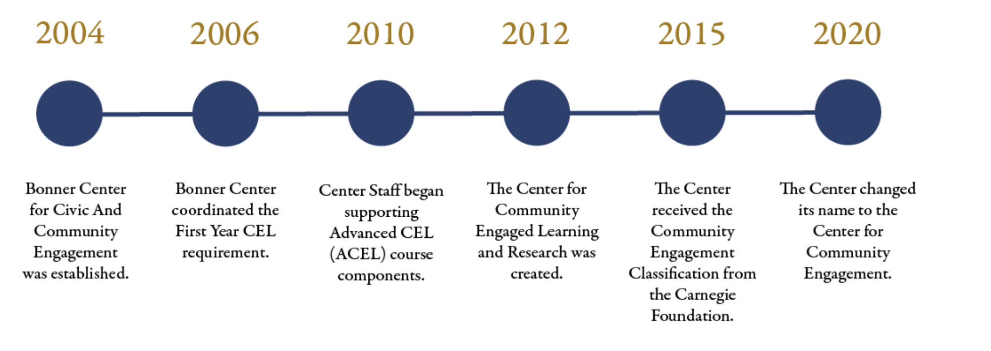
History

Slide 20
Center for Community Engagement
Community Engaged Learning Institute + Bonner Institute
Center for Community Engagement
Community Engaged Learning Institute
First-Year CEL Experience
Introductory & Advanced CEL
Community Engagement
NJ Bonner AmeriCorps Program
Bonner Institute
Bonner Community Scholars Program
Bonner Volunteers
Notes:
Bonner Director - Althia Muse - musea@tcnj.edu

Slide 22
Faculty Engagement Opportunities
First-Year CEL
Introductory or Advanced CEL
Individual Faculty Projects

Slide 23
Facilitate FYCEL
2-week course, 18-20 students
3 class sessions + 1 service experience
Content complete, no grading
$500 stipend per section taught
Faculty Engagement Opportunities

Slide 24
First-Year CEL Experience
FYC 100, the First-Year Community Engaged Learning (FYCEL) co-curricular program, is intended for first-year students to better understand who they are and to learn from their experiences before entering the local community through education, service, and reflection. This is what we cover in the four-day experience:
education
reflection
community
engaged learning
Students learn about CEL, the place where the learning objectives of TCNJ and community-identified needs align based on taking perspective, addressing power, involving people, and imagining possibilities.
cycle of socialization
Students review the concept of socialization, with Senloy & DiAngelo’s definition and Harro’s model.
what?
Students share and reflect on what they chose for their service and why.
so what?
Students discuss why this course this matters, what they are passionate about and how it connects to the content covered in days 1 and 2.
personal and social identities
Students introduce themselves through personal and social identities; reflect on which identities impact them in different ways.
service
day 3
day 1
day 2
day 4
the danger of
a single story
Students consider what happens when we are socialized to only know a dominant narrative about particular groups of people or places, with Chimamanda Ngozi Adichie’s TED Talk; introduced the concept of counternarrative.
local perspectives
& census data
Students hear from students and staff from the local community and review differences between Trenton, Ewing, and Princeton, census block data and demographic data.
now what?
Students consider what they will do next and how they will take action. Facilitators share information on organizations to continue service locally and virtually, encourage civic participation through service, politics, activism and education. Shared ideas on how to stay involved in CEL at and around TCNJ.
history
of TCNJ & Trenton
Students learn about the history of redlining and school desegregation, with a lecturette from history faculty Dr. Rob McGreevey, as an example of how the past still impacts the present and to contextualize the relationship of Trenton and TCNJ.
Students complete a 4 hour service experience organized by CEL staff.

Slide 25
Teach Introductory / Advanced CEL
Integrate CEL into
Classes
Examples
Internships
Independent study
Individual Faculty Projects
Workshops
Grant collaborator
CEL-by-Contract (proposal in governance)
Faculty Engagement Opportunities

Slide 26
Teach Introductory / Advanced CEL
Develop Pathways
Require major courses with CEL
Interest areas
ACEL Requirements
Social Justice Minor
Honors Program (proposal in governan
Integrate CEL work into department Disciplinary Standards
Connect to Career and Global experiences
Faculty Engagement Opportunities

Slide 27
CEL Designation Requirements & Approval Process
Requirements
Introductory CEL
Address 2 CEL Learning Goals
Minimum of 10 hours of action
Reflection
Graded Assignment
Advanced CEL
Address 3 CEL Learning Goals
Minimum of 20 hours of action
Reflection
Graded Assignment
Approval Process
Faculty Member Submits Application / Renewal Form
CEL Coordinator Initial Review and Approval
CEL Institute Approval
CEL Council Approval
Designation is added to class (not course) in PAWS

Slide 28
CEL Application Deadlines
Fall Semester
BATCH 1: Applications due March, approved at April CEL Council Meeting
BATCH 2: Applications due end of August, approved at September CEL Council Meeting
Spring Semester
BATCH 1: Applications due September, approved at October CEL Council Meeting
BATCH 2: Applications due end of January, approved at February CEL Council Meeting

Slide 29
Resources
Available

Slide 30
Teach Introductory / Advanced CEL
Staff Support
designing CEL classes
finding community partners
creating assignments (e.g., reflection)
Supporting logistics (e.g., organizing transportation)
Budgetary Support
supplies
partner stipends/honorariums
Resources Available

Slide 31
Teach Introductory/Advanced CEL
Teaching Resources
Tips to continue FYCEL learning
ICEL/ACEL course development
Coming… CETL website
Assessment Resources
Assignment rubrics
Assessment rubrics (e.g., AAC&U)
Coming… TCNJ Learning Goals
CONTACT ME
Resources Available

Slide 32
Discussion Question
What’s a useful format for professional development and sharing resources?
CEL day-long working institutes (June)
Brown Bag didactic lunch session or colloquium series
Small group half-day targeted working institutes (e.g., ICEL/ACEL development, Assessment, Ethics, CEL Scholarship)

Slide 33
What’s Next
Carnegie Classification for Community Engagement
Look out for for upcoming announcements
New / Updated Resources
CETL website
Today!
Lunch discussion session

Slide 35
Community Engagement Initiatives

Slide 36
CEL Community Partners
Arc Mercer
Arm in Arm
Atlantic Center for Capital Representation
Children's Futures
Community Outreach Garage
Eastern Service Workers Association
East Trenton Collaborative
Ewing Community Garden
Habitat for Humanity Restore
HomeFront
Isles Inc.
Trenton Community Street Team
League of Women Voters
Maker's Place
Meals on Wheels
Mercer County
Human Services
Parks Commission
Mercer Street Friends
Millhill Child and Family Development
Rolling Harvest Food Rescue
Passage Theater
Princeton YMCA
South Hunterdon School District
TCNJ
Campus Garden
TCNJ Votes
Trenton Area Soup Kitchen
Trenton Circus Squad
Trenton Cycling Revolution
Trenton Free Public Library
Trenton Health Team
Trenton Police Department
Trenton Public Schools
UrbanPromise
William Trent House

Slide 37
CEL Institute Staff
Brittany Aydelotte, CEL Director
Megan Teitelbaum, CEL Manager
Rayjohn Felicia, CEL Coordinator
Lori Johansson, CEL Coordinator
He Len Chung, CEL Faculty Fellow
Center for Community Engagement Team
Bonner Institute Staff
Althia Muse, Bonner Director
Katie Kahn, Bonner Program Manager
Destiny De La Rosa, Bonner Coordinator
Sam Kanig, Bonner Coordinator
Center Staff
Amy Loprinzi, Finance and Admin Services Coordinator
Victor Deihl, Office Coordinator
Kristi Cordier, NJ Bonner AmeriCorps Director
Natasha Shabazz, Community Outreach Specialist

